Slide 1
JPA/JPQL Query Performance
Scott Faria, Profiler
Notes:
Author
Scott Faria
Title
JPA/JPQL Query Performance
Abstract
JPA and JPQL make writing CRUD-style database applications fast and easy. Using it comes with a cost -- it is very easy to write JPQL that performs very poorly. This talk will cover the basics of JPA/JPQL, how it relates to the SQL it generates, some common performance pitfalls, anti-patterns and ways of mitigating these issues.
Talk Content:
What is JPA/JPQL?
How does it differ from just writing SQL?
Where you can go wrong, and understanding why it went wrong.
How you can fix things when they go wrong.
Debugging performance issues with JPQL.
More ways of increasing performance and best practices.

Slide 2
Overview
What is JPA/JPQL?
Where you can go wrong, and understanding why it went wrong.
How you can fix things when they go wrong.
Debugging performance issues with JPQL.
More ways of increasing performance and best practices.

Slide 3
What is JPA?
Java Persistence API
Java’s API spec that describes the management of relational data in an application using Java objects.
Three parts:
The API in javax.persistence.
Java Persistence Query Language (JPQL)
Object/relational metadata

Slide 4
What about JPQL?
Platform-independent object-oriented query language.
In short, it simplifies the writing of SQL using a SQL-like syntax that operates on Java objects instead of record sets.

Slide 5
Entities?
Directly model tables in the relational database.
Each instance of an Entity represents a single row in that table.
Entities can have relationships to other entities.
@OneToOne
@OneToMany
@ManyToOne
@ManyToMany

Slide 6
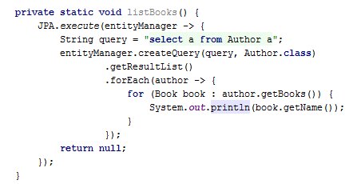
What can go wrong?
Consider the following simple JPQL query and code:
Simple, right?

Slide 7
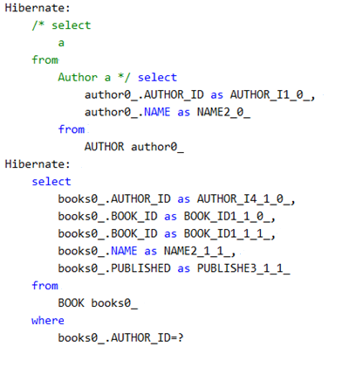
What can go wrong?
To see what went wrong, we should look to see what SQL gets generated when we run that code.

Slide 8
What can go wrong?
That’s 2 separate queries for each and every item in the returned list.
This can get amazingly expensive for large datasets.
Fetching strategy is to blame
Hibernate (our JPA implementation of choice) defaults to “Lazy” fetching of child collections.
Faster if you never expect to access child collections.
Commonly known as the n+1 query problem in JPA.

Slide 9
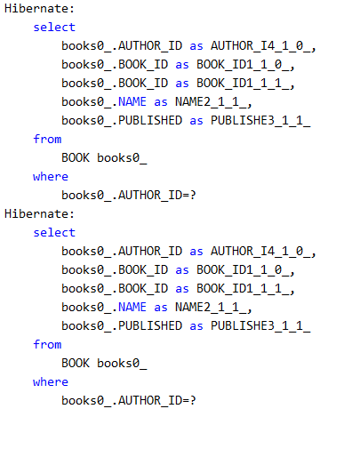
What can go wrong?
What about “Eager” fetching?

Slide 10
What can go wrong?
What is the difference?
JPA/Hibernate made the same number of queries, but instead chose to do them before materializing the collection.
Probably not what you want.

Slide 11
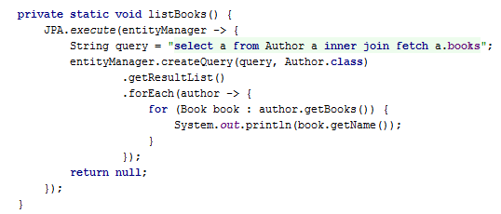
What can go wrong?
Lets make a little edit to our code!

Slide 12
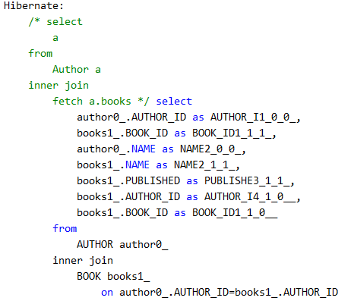
What can go wrong?
Getting there! We’re down to a single query!

Slide 13
What can go wrong?
1 query was made, but we have way too many results!
Hibernate has directly joined the AUTHOR table to BOOK
Our result set now has a size of n authors * m books.
Definitely not what we wanted or expected!

Slide 14
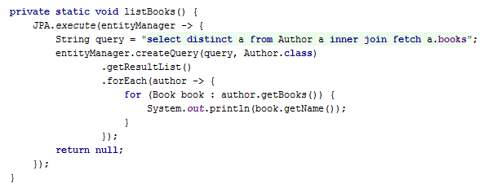
What can go wrong?
There, I fixed it:

Slide 15
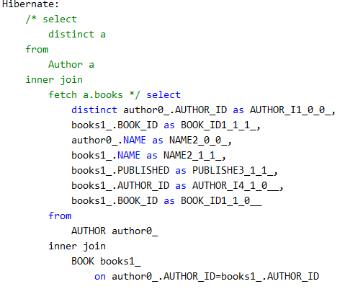
What could go wrong?
This finally produces the result set of objects we were looking for.

Slide 16
What could go wrong?
Some red flags here!
DISTINCT keyword
We’re Java object based, so the semantics of this depend on the equals method on the entity object.
Change the SELECT statement, you can drastically change the result set that’s returned.
The dataset returned is still quite large.

Slide 17
Well, what’s the best approach?
Honest answer: There isn’t a best approach.
The best way is to simply think of how your JPQL query is going to be used and pick the best strategy.
Preferring lazy fetching is often a good approach.
Use pagination! It’s built into JPA for a reason!
Minimize your result sets as much as possible.
Just need an ID? Only return it instead of the whole object.

Slide 18
How to fix stuff when it goes wrong
One tradeoff of the JPA/ORM approach is a lack of transparency.
With SQL you are generally in direct control of what gets executed on the RDBMS server.
Lack of transparency when dealing with managed objects.
Logging!
Most JPA implementations like Hibernate have incredibly useful logging switches.
Check your implementation’s documentation for the flags needed to enable things like:
JPA query output
SQL query logging
Query plan output

Slide 19
Other ways to improve performance
Keep your entities as simple as possible!
Caching!
JPA has what is called a Level 2 cache, with two modes:
Object cache.
Query cache.
Different use cases, pick the one that makes most sense for your
application.
Object cache is good for retrieving the same object by id without hitting the db.
Query cache is best for general queries that are run often.

Slide 20
Fin
Questions?
Slides and code are on github: https://github.com/sfaria/jpa-demo

